Slide 1


Network QoS
Associate Professor
Department of Computer Science and Engineering

Slide 2
Session Objectives
After completion of the session you will be able to understand
What is QoS?
Parameters for QoS
Traffic Scheduling and Shaping Approaches

Slide 3
Introduction
Quality of service (QoS) is an internetworking issue and mainly related to Network performance.
Ability to dependably run high-priority applications and traffic under limited network capacity.
Deals with capacity allocation to specific flows in network traffic.
Measurements of concern to QoS are bandwidth (throughput), latency (delay), jitter (variance in latency), and error rate.
The QoS mechanisms for ordering packets and allotting bandwidth are queuing and bandwidth management respectively.
Mechanisms for bandwidth management include traffic shaping, a rate limiting technique used to optimize or guarantee performance and increase usable bandwidth where necessary, and scheduling algorithms

Slide 4

Traffic Flow Characteristics

Slide 5
Contd….
Reliability Reliability is a synonym for assurance and a reliable service is one that notifies the user if delivery fails.
Delay is a situation in which something happens later or more slowly than expected or scheduled.
Jitter is defined as a variation in the delay of received packets. At the sending side, packets are sent in a continuous stream with the packets spaced evenly apart. Due to network congestion, improper queuing, or configuration errors, this steady stream is distorted.
Bandwidth is the capacity of a wired or wireless network communications link to transmit the maximum amount of data from one point to another over a computer network or internet connection in a given amount of time.

Slide 6
Techniques to Improve QoS
Some techniques that can be used to improve the quality of service are:
  Traffic Scheduling; FIFO, Priority Queue, Weighted Queue
  Traffic shaping; Leaky Bucket and Token Bucket
  Admission control
  Resource reservation.

Slide 7

FIFO Queue Scheduling

Slide 8

Priority Queue Scheduling

Slide 9

Weighted Fair Queue Scheduling

Slide 10
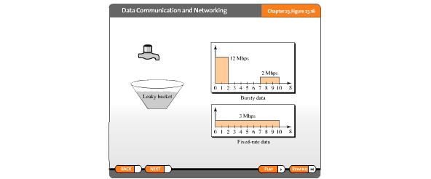

Leaky Bucket Traffic Shaping Algorithm
Leaky bucket implementation

Slide 11
Leaky Bucket Algorithm Features
The leaky bucket algorithm is a method of temporarily storing a variable number of requests.
Organizing requests into a set-rate output of packets in an asynchronous transfer mode network.
It is used to implement traffic policing and traffic shaping in Ethernet and cellular data networks.
A leaky bucket algorithm shapes bursty traffic into fixed-rate traffic by averaging the data rate. It may drop the packets if the bucket is full.
The leaky bucket algorithm can also detect both gradually increasing and dramatic memory error increases by comparing how the average and peak data rates exceed set acceptable background amounts.

Slide 12

Token Bucket Traffic Shaping Algorithm

Slide 13
Token Bucket Algorithm Working
A token is added to the bucket every 1/r seconds.
The bucket can hold at the most b tokens. If a token arrives when the bucket is full, it is discarded.
When a packet of n bytes arrives, n tokens are removed from the bucket, and the packet is sent to the network.
If fewer than n tokens are available, no tokens are removed from the bucket, and the packet is considered to be non-conformant.
Example: if n is 100 and the host is idle for 100 ticks, the bucket collects 10,000 tokens. Now the host can consume all these tokens in one tick with 10,000 cells, or the host takes 1000 ticks with 10 cells per tick. In other words, the host can send bursty data as long as the bucket is not empty.

Slide 14
Summary
In this session we have learned
Quality of Service
Traffic Scheduling Methods
Traffic Shaping Methods

Slide 15

Notes:
1.#

